Slide 1
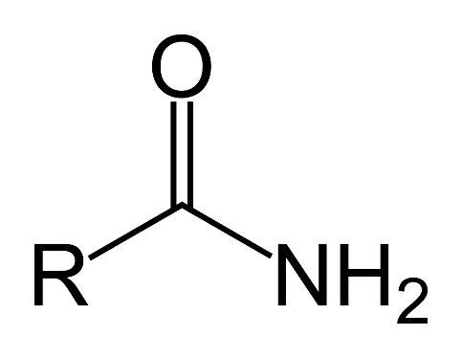
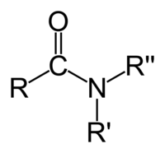
What are AMIDES?
Amides are derivatives of carboxylic acids, where the hydroxyl group has been replaced by an amino group.
Carboxylic acid + ammonia=
Carboxylic acid + 1° or 2° amine=

Slide 2
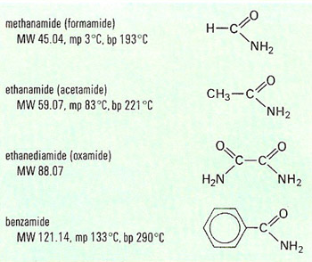
Most common amides:

Slide 3
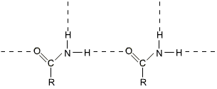
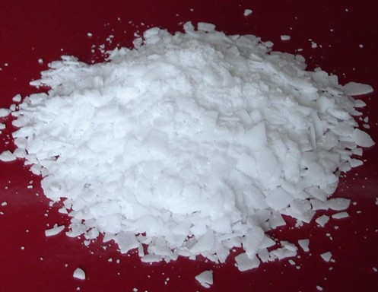
Physical properties:
Methanamide is a liquid at room temperature (melting point: 3°C), but the other amides are solid.
For example: ethanamide forms colorless deliquescent crystals with a melting point of 82°C.
(A deliquescent substance is one which picks up water from the atmosphere and dissolves in it.)
Ethanamide crystals nearly always look wet.
The melting points of the amides are high for the size of the molecules because they can form hydrogen bonds.

Slide 4
Physical properties:
Solubility:
The small amides are soluble in water because they have the ability to hydrogen bond with the water molecules.
Compared to amines, amides are very weak bases.

Slide 5
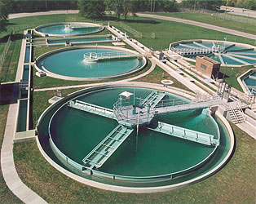

Uses of amides:
Amides are used widely in industry.
Amides are found in the plastic and rubber industry, paper industry, water and sewage treatment, in crayons, pencils and inks.
Polyacrylamide is used in the treatment of drinking water and sewage.
The paper industry takes a lot of polyacrylamide produced, being used as a binder and for retention aids for fibers. It also retains the color pigments on the paper.
Amides are also used for explosives, adhesives, printing inks, latex thickeners and emulsion stabilizers, but these are on a much lower scale to the ones stated before.

Slide 6
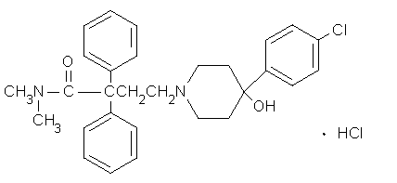
Medical uses of amides
Sedatives
Anticonvulsant of epileptic
Anti-diarrheal:
Pain reliever

Slide 7

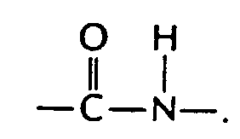
Polyamides:
Nylon and Kevlar
Polyamides are polymers where the repeating units are held together by amide links.
An amide group has the formula - CONH₂. An amide link has this structure:
In an amide itself, of course, the bond on the right is attached to a hydrogen atom.

